Slide 1

HR AND ADMIN

Slide 2
สารบัญ
User story
Languages
System user case
System user case for User
System user case for Admin
System user case for HR
System user case for Manager
System user case for Supervisor
EMPLOYEE
Employee master
Class diagram employee
Activity diagram employee master
User interface employee master
New employee master
Activity diagram new employee master
User interface new employee master
ATTENDANCE
Attendance
Class diagram attendance
Activity diagram attendance
User interface attendance
Data Attendance
Activity diagram data attendance
User interface data attendance
Approve by supervisor
Activity diagram approve by supervisor
User interface approve by supervisor
Approve by manager
Activity diagram approve by manager
User interface approve by manager

Slide 3
OVER TIME
Over time
Class diagram over time
Activity diagram over time
User interface over time
Data over time
Activity data over time
User interface data over time
Approve over time
Activity approve over time
User interface approve over time

Slide 4
User story
ในฐานนะเจ้าหน้าที่ HR
เราต้องการระบบ ลางาน,โอที ผ่านเว็ปไซต์หรือออนไลน์ โดยผ่าน manager และ supervisor
เพื่อสะดวกและรวดเร็วในการจัดการ

Slide 5
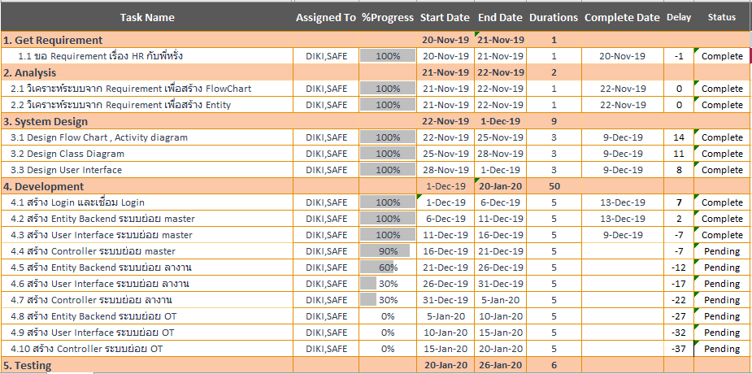

Slide 6
ภาษาที่ใช้
JAVA
HTML
CSS
Type Script
Framework Angular

Slide 7
SYSTEM USE CASE

Slide 8
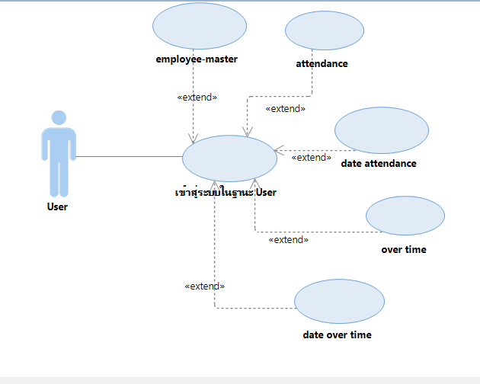
System Use Case For User

Slide 9
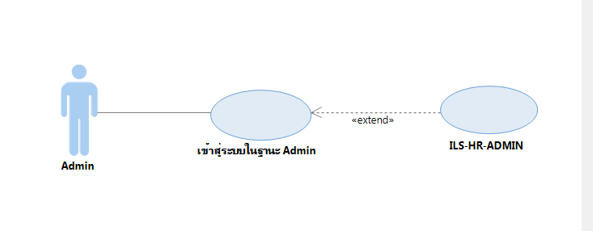
System Use Case For Admin

Slide 10
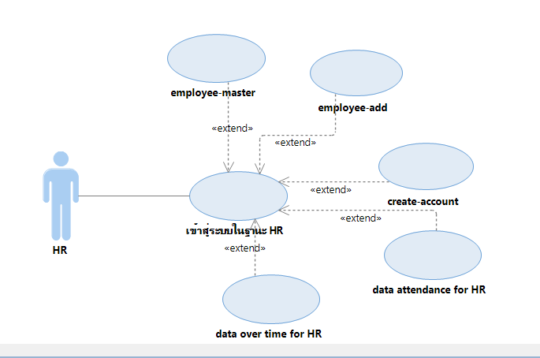
System Use Case For HR

Slide 11
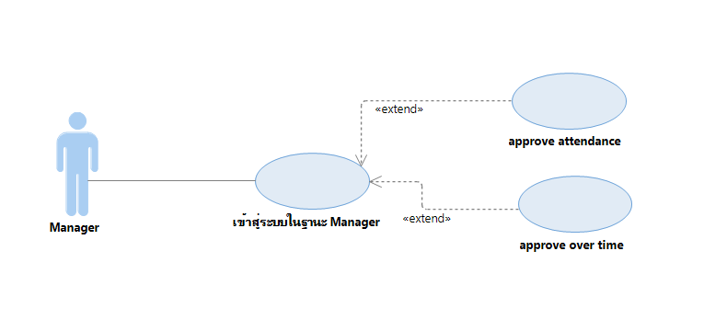
System Use Case For Manager

Slide 12
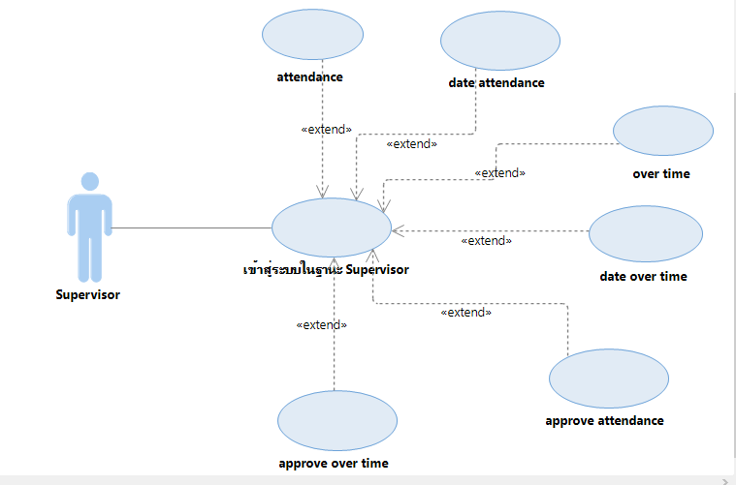
System Use Case For Supervisor

Slide 13
EMPLOYEE MASTER

Slide 14
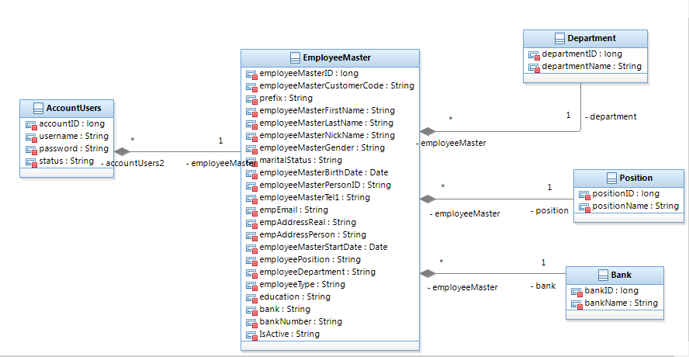
Class Diagram Employee

Slide 15
Activity Diagram Employee master

Slide 16
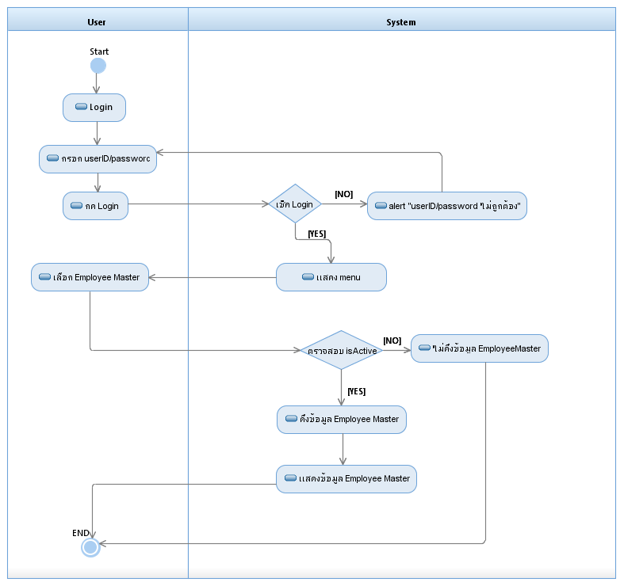

Slide 17
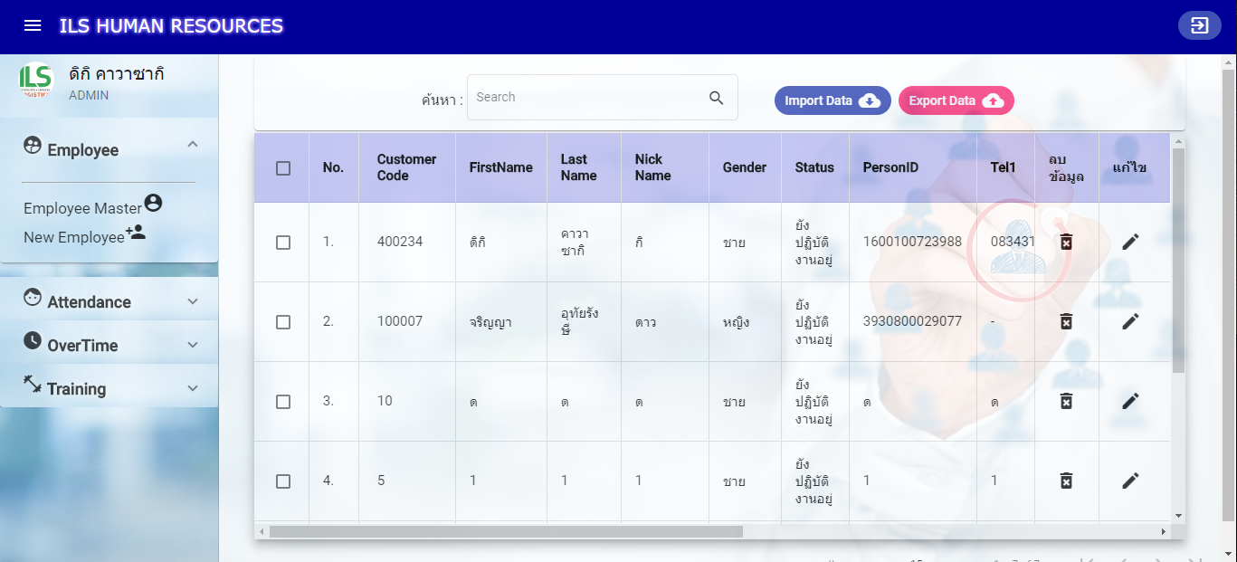
User Interface Employee master

Slide 18
NEW EMPLOYEE MASTER

Slide 19
Activity Diagram
New employee

Slide 20
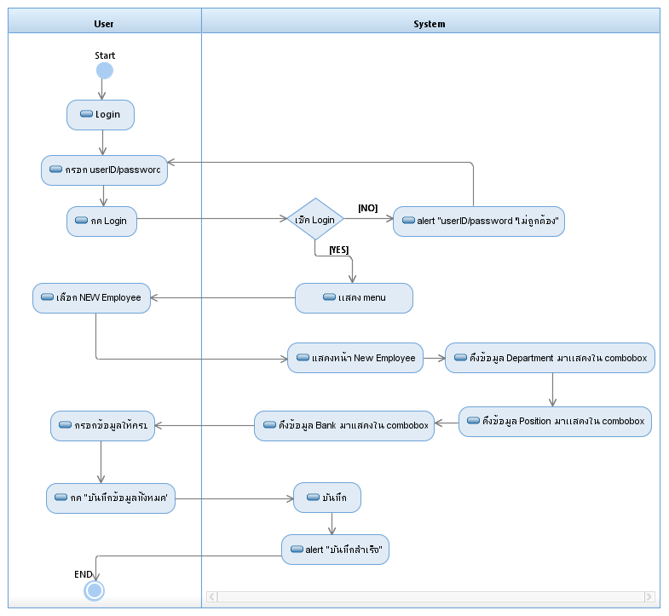

Slide 21
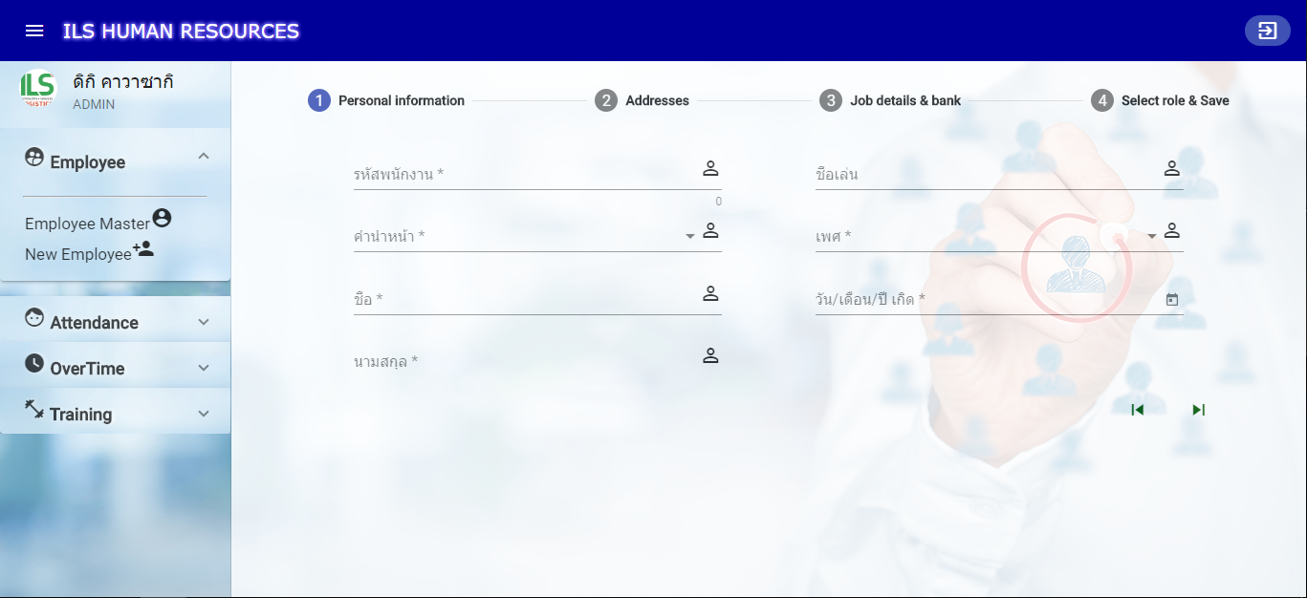
User Interface New Employee master

Slide 22
CREATE NEW ACCOUNT

Slide 23
ATTENDANCE

Slide 24
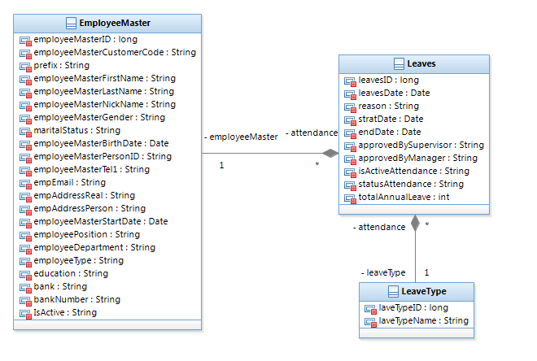
Class Diagram Attendance

Slide 25
Activity Diagram Attendance

Slide 26
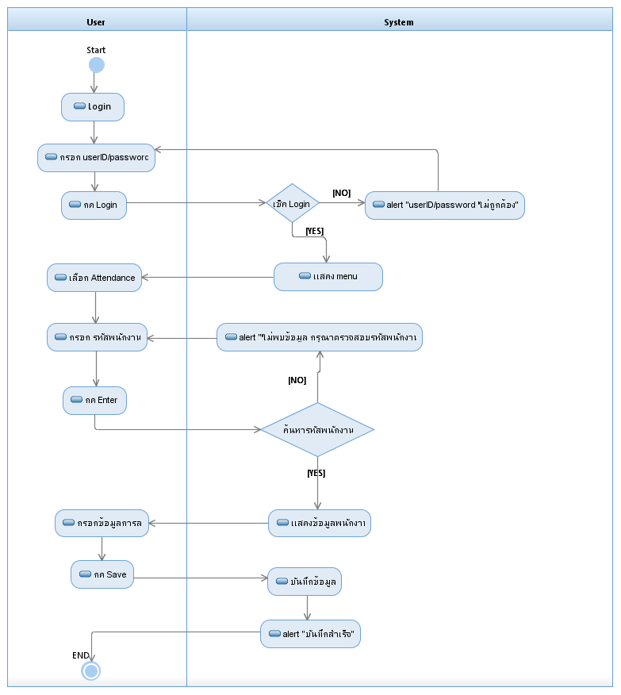

Slide 27
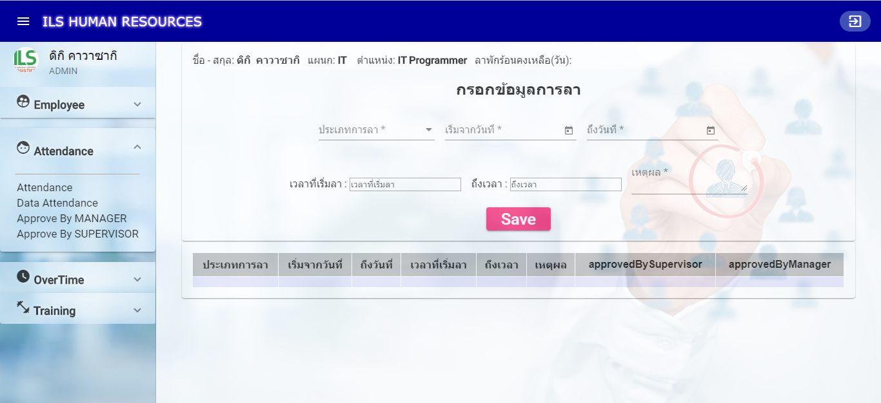
User Interface Attendance

Slide 28
DATA ATTENDANCE

Slide 29
Activity Diagram
Data Attendance

Slide 30
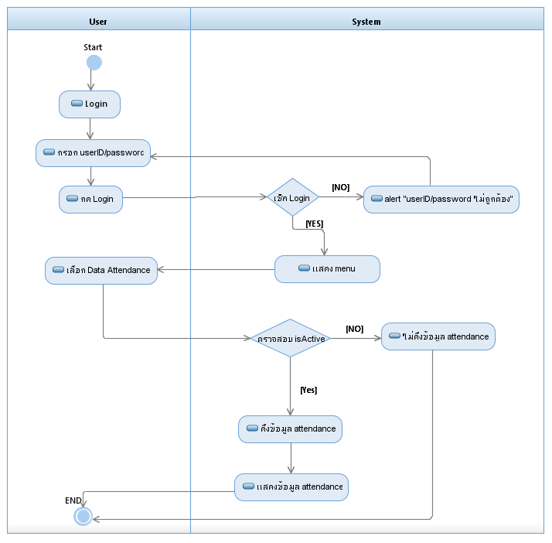

Slide 31
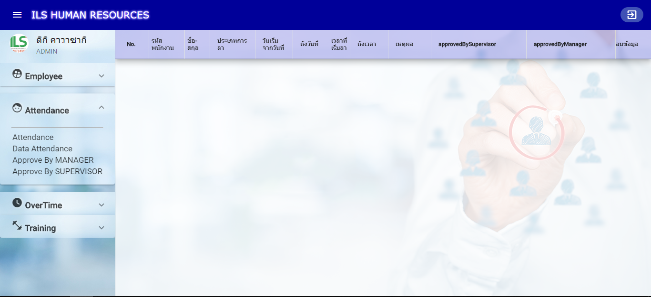
User Interface Data attendance

Slide 32
APPROVE BY SUPERVISOR

Slide 33
Activity Diagram
Approve by supervisor

Slide 34
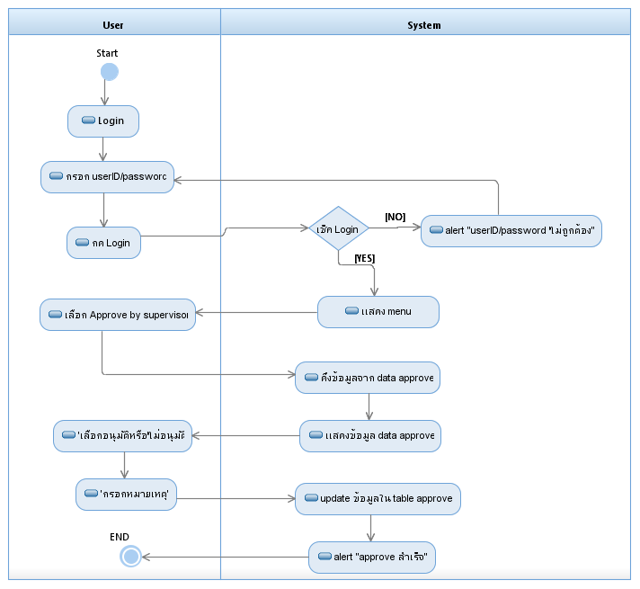

Slide 35
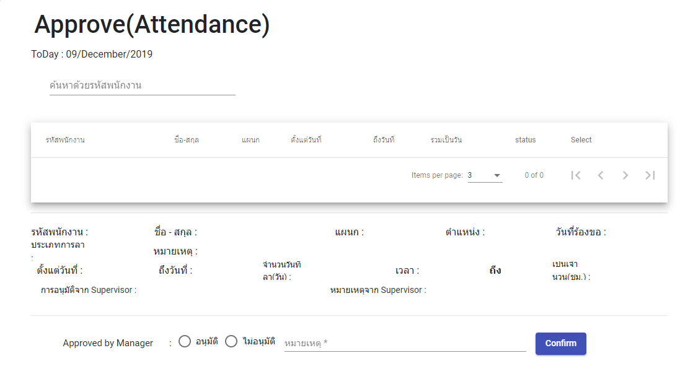
User Interface Approve by supervisor

Slide 36
APPROVE BY MANAGER

Slide 37
Activity Diagram
Approve by manager

Slide 38
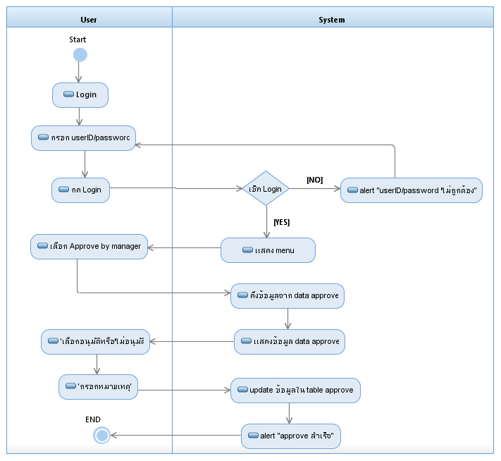

Slide 39
User Interface Approve by manager

Slide 40
OVER TIME

Slide 41
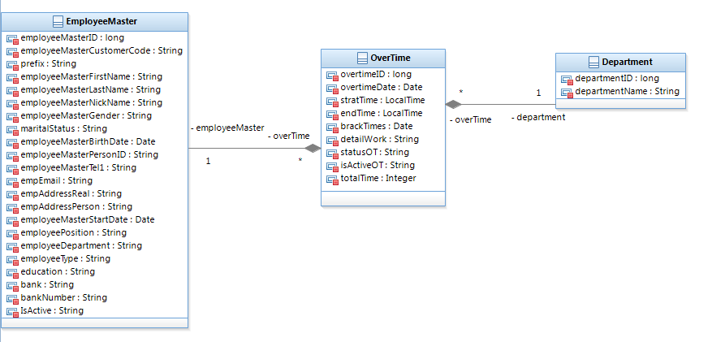
Class Diagram Over Time

Slide 42
Activity Diagram
Over Time

Slide 43
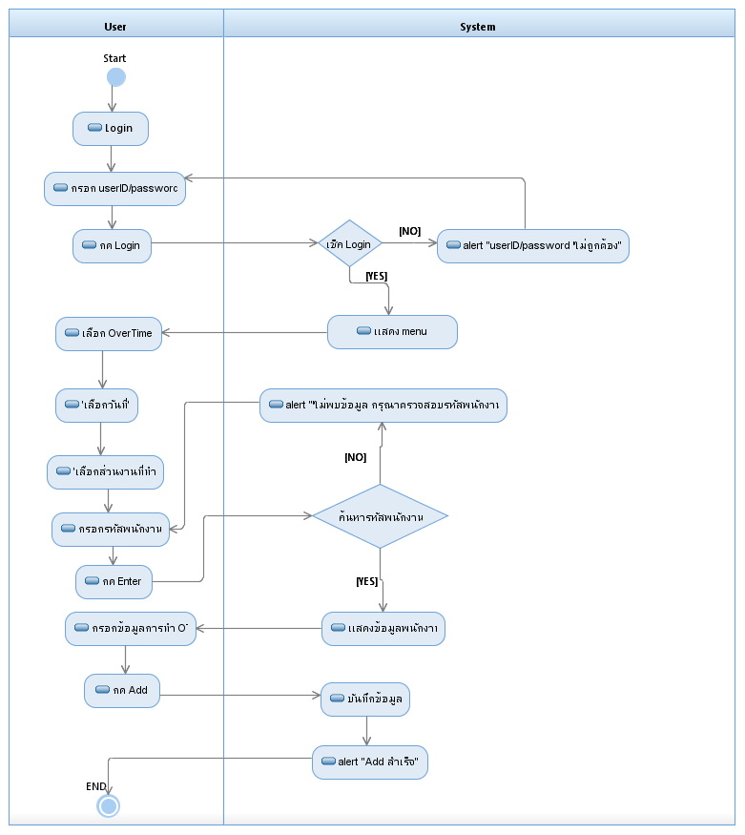

Slide 44
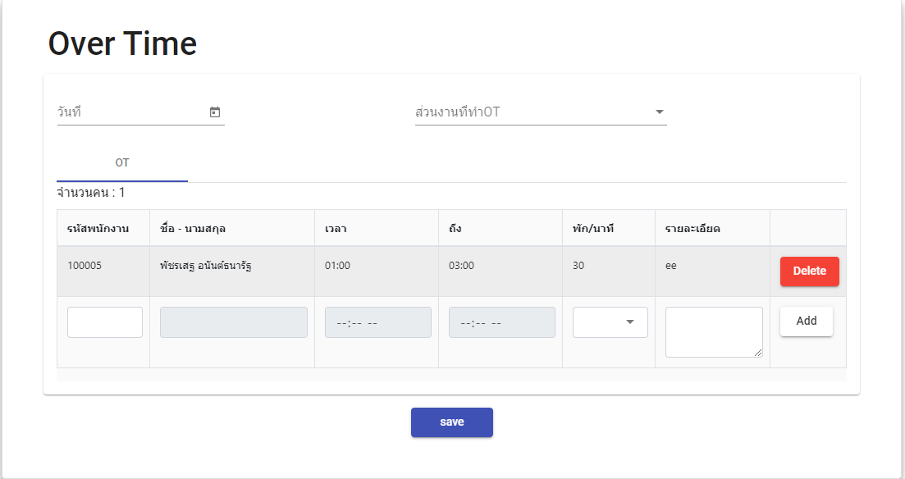
User Interface Over Time

Slide 45
DATA OVER TIME

Slide 46
Activity Diagram
Data Over Time

Slide 47


Slide 48
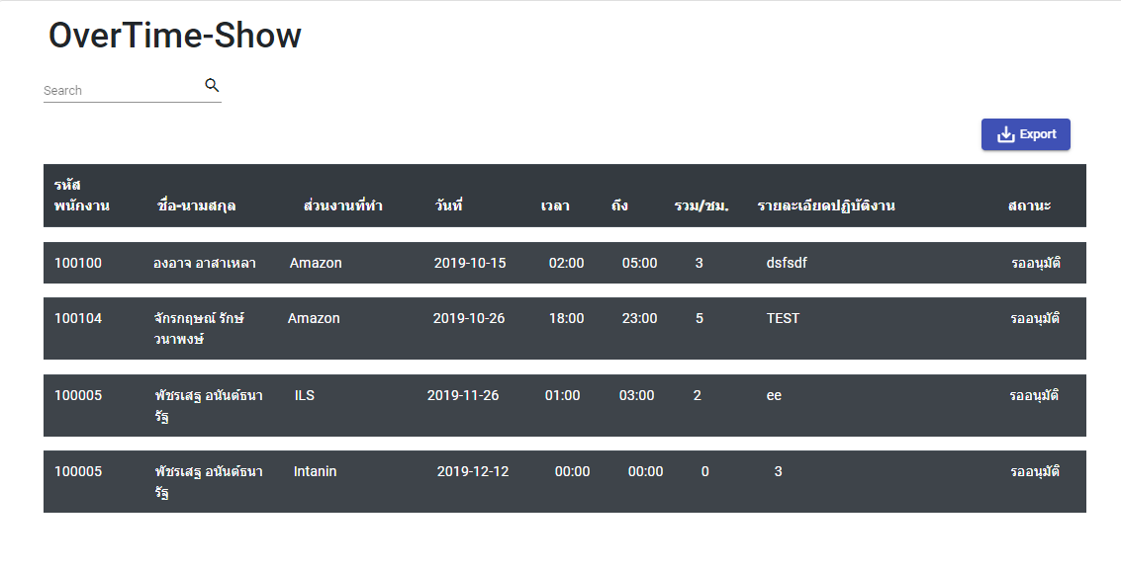
User Interface Date Over Time

Slide 49
APPROVE OVER TIME

Slide 50
Activity Diagram
Approve Over Time

Slide 51
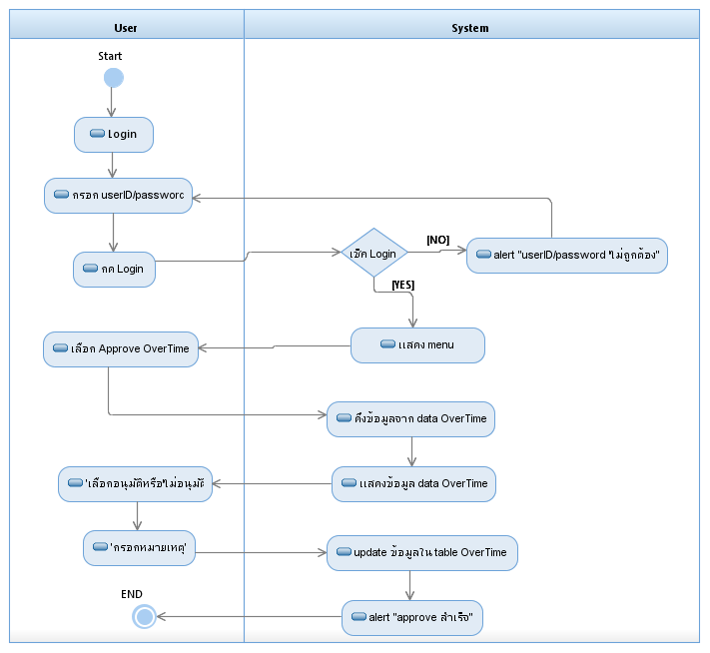

Slide 52
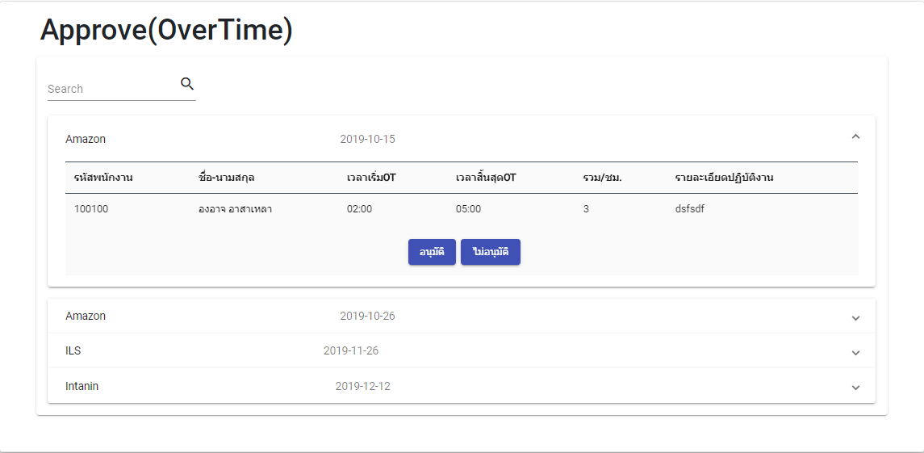
User Interface Approve Over Time

